Slide 1

8
Supporting PREP2 predictions
PREP2
*Name*
On behalf of *Organisation* PREP2 Implementation Team
Notes:
*Add name of presenters*
*Add name of organisation*

Slide 2
Can we tell a stroke patient with new arm weakness whether their arm will get better?
What time frame can we predict for?
How soon can we know?
How certain can we be?
8
After
stroke…

Slide 3
PREP2 development
Predictions based on clinical assessment alone are difficult
Nijland et al., Physical Therapy 2013
PREP2 implemented at ADHB
PREP2 implemented at WDHB
Biomarkers identified in 21 chronic patients
Brain
PREP developed in 40 subacute patients
Brain
PREP validated in 192 subacute patients
Stroke
PREP revised for clinical use in 207 subacute patients
Ann Clin Transl Neurol
PREP2 predictions accurate at 2 years post-stroke
NNR
2007
2008
2009
2010
2011
2012
2013
2014
2015
2016
2017
2018
2019
PREP proposed
Lancet Neurology
Biomarkers of motor recovery reviewed
Lancet Neurology
Implementation of PREP2
NeuroRehabilitation
Notes:
Clinicians often find it difficult to accurately predict functional outcomes for the upper limb after stroke, and research has found an overall accuracy of only 59%. Predictions are particularly difficult for patients with moderate to severe initial impairment.
PREP2 has been developed to help clinicians make more accurate predictions of upper limb functional outcome, to guide rehabilitation for individual patients.
PREP2 is an prediction tool that is used within days of stroke to predict upper limb functional outcome within 12 weeks after stroke.
It has been developed to help clinicians make more accurate predictions of upper limb functional outcome, to guide rehabilitation for individual patients.
It’s been worked on for over a decade:
- Back in 2007, key biomarkers of upper limb motor performance in chronic stroke patients were identified, and this was published in the journal Brain.
- Then the PREP prediction tool was proposed in the Lancet Neurology, and the development of the prediction tool in 40 subacute patients published in 2012.
Over the next 5 years, hard work was put in to validate the prediction tool in a separate group of 192 subacute patients, and this was published in early 2017. In the same year, the prediction tool was revised with data from 207 subacute patients, making it easier to use in clinical practice. A review of biomarkers of motor recovery after stroke was also published in Lancet Neurology.
Most importantly, the researchers have supported the implementation of the PREP2 prediction tool in clinical practice in Auckland, NZ, where it is now routine clinical care, requiring no further input from the research team. The allied health team run this independently. Early 2018 a review of the key factors involved in implementing PREP2 was published.
Now the researchers are excited to be supporting implementation of PREP2 at other hospitals in New Zealand and around the world.
And in 2019 the researchers published a study showing that PREP2 predictions are correct for 80% of patients at 2 years post-stroke, which is very reassuring.
References
Stinear CM, Barber PA, Smale PR, Coxon JP, Fleming MK, Byblow WD. Functional potential in chronic stroke patients depends on corticospinal tract integrity. Brain 2007 130(1): 170-80. DOI:10.1093/brain/awl333. PMID: 17148468
Stinear CM. Prediction of recovery of motor function after stroke. Lancet Neurol 2010 9(12): 1228-32.
DOI: 10.1016/S1474-4422(10)70247-7. PMID: 21035399
Stinear CM, Barber PA, Petoe M, Anwar S, Byblow WD. The PREP algorithm predicts potential for upper limb recovery after stroke. Brain 2012 135(8): 2527-35. DOI: 10.1093/brain/aws146. PMID: 22689909
Stinear CM, Byblow WD, Ackerley SJ, Barber PA, Smith MC. Predicting recovery potential for individual patients increases rehabilitation efficiency after stroke. Stroke 2017 48(4): 1011-9.
DOI: 10.1161/STROKEAHA.116.015790 PMID: 28280137
Stinear, CM. Prediction of motor recovery after stroke: advances in biomarkers.
Lancet Neurol 2017 16(10): 826-836. DOI: 10.1016/S1474-4422(17)30283-1 PMID: 28920888
Stinear CM, Byblow WD, Ackerley SJ, Smith MC, Borges VM, Barber PA. PREP2: A biomarker-based algorithm for predicting upper limb function after stroke. Ann Clin Transl Neurol 2017: 1-10. DOI: 10.1002/acn3.488
Connell LA, Smith MC, Byblow WD, Stinear CM. Implementing biomarkers to predict motor recovery after stroke. Neurorehabilitation 2018: 43(1): 41-50. DOI: 10.3233/NRE-172395.

Slide 4
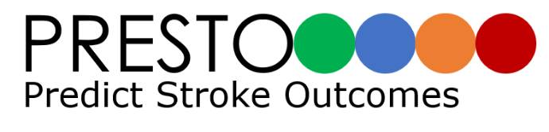

www.presto.auckland.ac.nz
www.preptraining.auckland.ac.nz
Notes:
I’ll talk you through PREP2 now, but more detail on PREP2 can be found at the PRESTO website and learning opportunities are available at the PREP2 training website, and I’ll put these up again at the end of the talk.

Slide 5
Why use the PREP2 prediction tool?
PREP2 predictions improve:
  - Clinician confidence
  - Tailoring of rehabilitation
  Rehabilitation efficiency
  Reduction in length of stay – 6 days (1 – 12 days)
PREP2 is based on simple and quick bedside measures for most patients
Within the first week after stroke, clear information can be provided about likely upper limb outcomes to patients and clinical teams
Prediction information can help with realistic goal setting and discharge planning for clinicians and patients
  Stinear et al., Stroke 2017
Notes:
Why use PREP2?
Research has shown that it increases clinician confidence that they know what to expect for their patient’s upper limb recovery.
This enables them to tailor their rehabilitation and therapy for each patient, and this in turn improves rehabilitation efficiency. It was also found that putting it into practice reduced the overall inpatient length of stay by an average of 6 days. And this was across the board, for mild, moderate, and severely affected patients.
PREP2 is simple and only involves quick bedside tests for the majority of people.
Within the first week after stroke, clear information can be provided to patients and clinicians about the likely upper limb outcome, and this can help with realistic goal setting and rehabilitation planning.
Reference
Stinear CM, Byblow WD, Ackerley SJ, Barber PA, Smith MC. Predicting recovery potential for individual patients increases rehabilitation efficiency after stroke. Stroke 2017 48(4): 1011-9. DOI: 10.1161/STROKEAHA.116.015790. PMID: 28280137

Slide 6
Which patients is PREP2 used for?
Age ≥ 18 years
New arm weakness due to ischaemic or haemorrhagic stroke
Can include:
Post tPA and clot retrieval
History of previous stroke
Not suitable for patients with:
Cerebellar stroke
Bilateral stroke
Notes:
PREP2 is suitable for most stroke patients.
It has been developed, validated and revised with patients aged at least 18 years and new arm weakness due to either ischaemic or haemorrhagic stroke.
PREP2 can be used with patients who have had thrombolysis and/or clot retrieval.
As well as patients with a history of previous stroke.
PREP2 may not be suitable for patients who have severe aphasia or cognitive impairment that limits their ability to understand the tests involved, or if there are contraindications to TMS.
PREP2 has not been tested with patients with cerebellar stroke or bilateral stroke

Slide 7
Implications
PREP2 prediction information can help with realistic goal setting and discharge planning for clinicians and patients
Information isn’t useful unless we use it!
Team all need to be the same page
Consistent message
Information needs to travel with the patient
Notes:
As mentioned, PREP2 prediction information can help set realistic goals for upper limb recovery and rehabilitation, and help make informed decisions regarding rehabilitation opportunities and discharge planning.
But….information isn’t useful unless we use it.
As a clinical team we all need to be on the same page, and giving the patient a consistent message.
Prediction information also needs to travel with a patient as they go through the rehabilitation services.

Slide 8
What does PREP2 mean for staff?
You don’t need to know how to do the PREP2 prediction tool, but you do need to be familiar with it in order to:
  Understand how the predictions were made
  Know what information has been given to your patient and their family early after stroke
  Know what that information looks like in the notes
  Be confident in supporting and repeating this information
  Consistency is key
Notes:
For staff who are not directly involved in obtaining the prediction you don’t need to know how to do the PREP2 prediction tool, but you do need to be familiar with it in order to:
understand how the predictions were made
know the information that the patient received depending on their prediction
recognise the documentation in the clinical notes and
be able to answer questions from the patient, or know who to ask for help, and be able to share prediction information with those who need it
A consistent approach is key
…so we are going to spend a little time now going through the prediction tool.

Slide 9
PREP2 prediction tool
EXCELLENT
< 80 y
SAFE ≥ 8
3 days
SAFE < 8
3 days
SAFE ≥ 5
3 days
GOOD
MEP+
3 – 7 days
NIHSS < 7
3 days
LIMITED
NIHSS ≥ 7
3 days
POOR
Stinear et al., Ann Clin Transl Neurol, 2017
Notes:
PREP2 starts within 3 days of stroke and requires 3 simple steps.
It predicts one of four upper limb functional outcomes at 12 weeks post-stroke.
Patients are given one of four upper limb predictions, and these can be used to focus rehabilitation.
Note
The four predictions are colour-coded, and the dots show the proportion of patients who can expect to achieve each predicted outcome, depending on their path through the prediction tool. For example, patients who have a SAFE score of 5 or more and are younger than 80 years old have an 85% chance of an Excellent upper limb outcome. Patients with a SAFE score of 8 or more and are older than 80 have a 60% chance of an excellent outcome.
Reference
Stinear CM, Byblow WD, Ackerley SJ, Smith MC, Borges VM, Barber PA. PREP2: A biomarker-based algorithm for predicting upper limb function after stroke. Ann Clin Transl Neurol 2017: 1-10. DOI: 10.1002/acn3.488

Slide 10
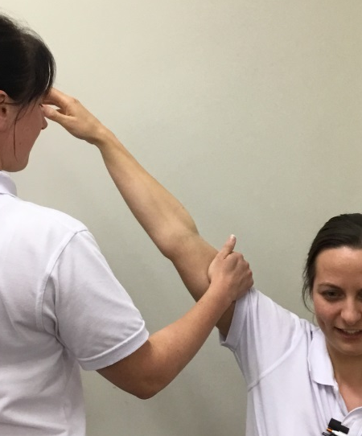
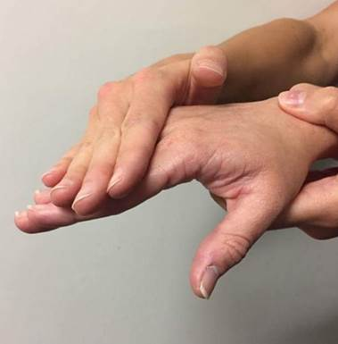
PREP2 prediction tool
EXCELLENT
< 80 y
SAFE ≥ 8
3 days
SAFE < 8
3 days
SAFE ≥ 5
3 days
GOOD
MEP+
3 – 7 days
NIHSS < 7
3 days
LIMITED
POOR
SAFE score out of 10
NIHSS ≥ 7
3 days
Stinear et al., Ann Clin Transl Neurol, 2017
Notes:
Step 1 is to establish the SAFE score at 72 hours after stroke.
The SAFE score stands for Shoulder abduction and Finger extension.
Testing is done at the patient's’ bedside on Day 3 by a trained physical or occupational therapist, using the Medical Research Council grades for muscle power.
Each movement is graded out of 5 and the scores are combined to produce the SAFE score out of 10.
For those with a SAFE score of 5 or more, age is used to determine the prediction, it will be either Excellent or Good.
Patients with a SAFE score of 5 or more that are younger than 80 years old receive an Excellent prediction.
Patients that are 80 or older receive an Excellent prediction if their SAFE score is 8 or 9, and a Good prediction if their SAFE score is 5, 6 or 7.

Slide 11
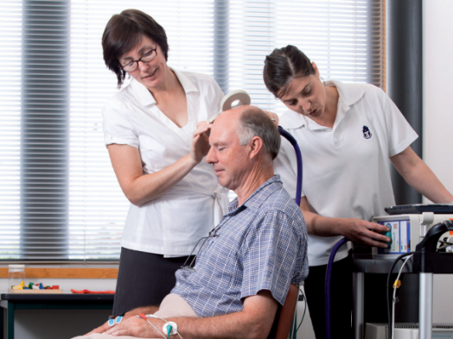
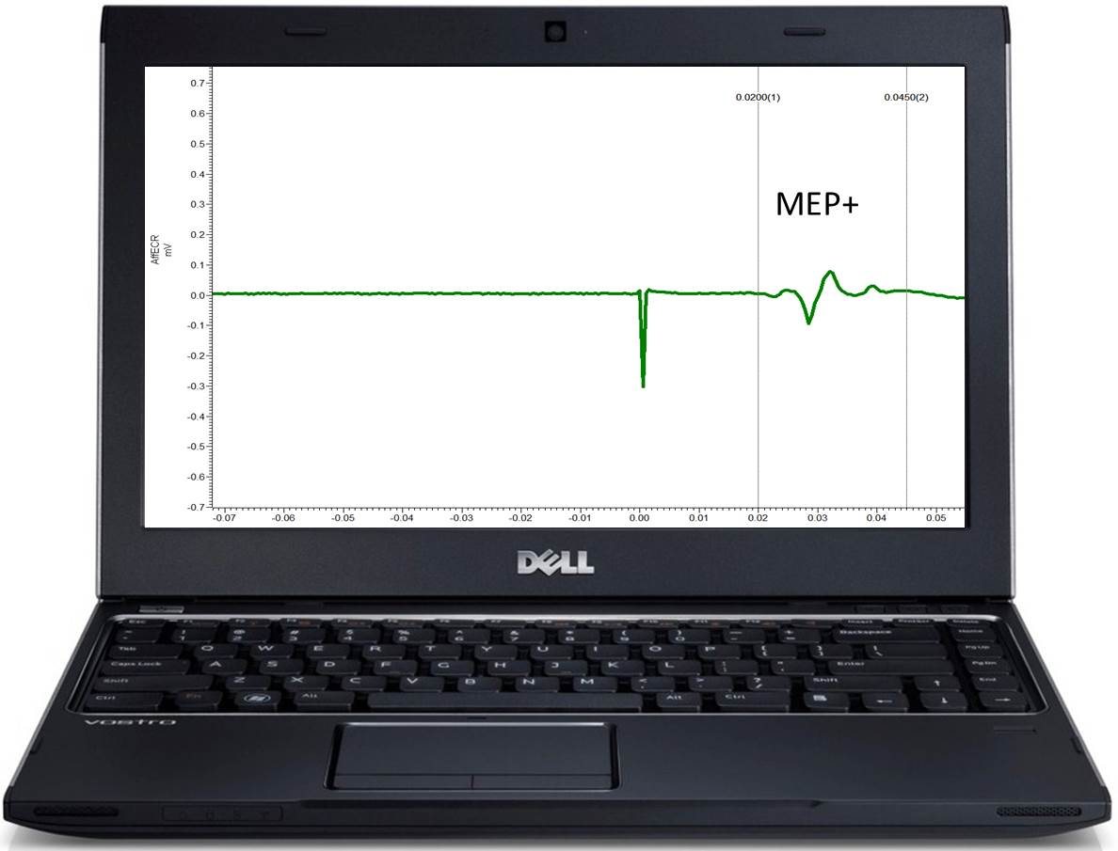
TMS testing
Assesses the function of the descending motor pathways to the affected upper limb
MEP response: MEP+ or MEP-
EXCELLENT
< 80 y
SAFE ≥ 8
3 days
MEP = Motor evoked potential
SAFE < 8
3 days
SAFE ≥ 5
3 days
GOOD
MEP+
3 – 7 days
Notes:
For those with a SAFE score less than 5, Step 2 is to test the function of descending motor pathways between the stroke-affected side of the brain to the weak upper limb using transcranial magnetic stimulation, or TMS, testing. This will determine the MEP response, whether the patient is MEP+ or MEP-.
TMS is a safe, painless, non-invasive technique for testing the function of the corticospinal tract.
TMS produces a very brief magnetic field that activates the neurons on the surface of the brain, and this produces a descending signal that can be detected in the muscles of the upper limb using surface electromyography (EMG).
During testing the TMS coil is held against the patient’s head over the area of the primary motor cortex.
When TMS is triggered the patient hears a clicking noise, and feels a light tap sensation on the head underneath coil.
If a response can be detected, it looks like this.
This wave is the motor evoked potential, or MEP. We would say this patient is MEP+.
If no response can be detected this line would be flat, and we the patient is MEP- at the time of testing.
TMS testing is done on the ward between days 3 – 7 after stroke by a staff member who has completed comprehensive TMS training.
All patients are screened for safety prior to TMS testing, using a standardised checklist that is reviewed and signed off by their physician.
Most people are safe for TMS but a few aren’t, for example people with a cardiac pacemaker or epilepsy. It’s similar to doing a checklist for MRI testing.

Slide 12
MEP +
EXCELLENT
< 80 y
SAFE ≥ 8
3 days
SAFE < 8
3 days
SAFE ≥ 5
3 days
GOOD
MEP+
3 – 7 days
Can have no upper limb movement early after stroke
Notes:
If a patient is MEP+ it means that the motor pathways from the stroke side of the brain to the affected hand and arm are functionally intact, in other words a message is able to get through, and this patient is most likely to have a Good outcome for their upper limb.
What’s exciting about this part of the prediction tool is that these patients can have SAFE scores as low as zero, meaning they don’t have even a flicker of muscle activity in their affected shoulder abductors or finger extensors.
Yet even though they are profoundly weak early after their stroke, if they have an MEP response to TMS they are still likely to have a Good outcome because their key motor pathways still work.
It’s very rewarding to be able to give this information to patients and their families, and can help to ensure that the patient gets the rehabilitation they need to reach their full potential.
These patients might find it hard to believe this information when they are first given it, and being able to reinforce the prediction may help a patient to understand their potential.

Slide 13
MEP -
EXCELLENT
< 80 y
SAFE ≥ 8
3 days
SAFE < 8
3 days
SAFE ≥ 5
3 days
GOOD
Obtain NIHSS on Day 3
MEP+
3 – 7 days
NIHSS < 7
3 days
LIMITED
NIHSS ≥ 7
3 days
POOR
Notes:
If, however, there is no response to TMS, the patient is MEP-, and now their upper limb outcome depends on their overall stroke severity.
Step 3 of the PREP2 prediction tool is to determine overall stroke severity using the National Institutes of Health Stroke Scale, or NIHSS, score. This score takes into account global stroke severity by including assessments of level of consciousness, vision, motor strength, ataxia, speech, language and sensory loss.
A NIHSS score will be obtained by a trained therapist on day 3 for all patients with a SAFE score less than 5 – though the score is only used for those who are found to be MEP-.
The NIHSS score will determine whether a patient receives a Limited or Poor prediction.
If the score is less than 7, indicating a more mild to moderate stroke, the patient is most likely to have a Limited upper limb outcome.
And if the score is 7 or more, indicating a more severe stroke, the patient is most likely to have a Poor upper limb outcome.

Slide 14
What are the risks?
Safety
  TMS approved by physician
Negative predictions
  Preparation and skill, patient support
Being wrong
  Careful language, not wrong by much
Notes:
But what are the risks of using the prediction tool?
First is always safety.
TMS is not appropriate for some patients, those with cardiac pacemakers for example.
As mentioned, a standardised safety screening checklist is used which obtains vital information regarding various absolute and relative contraindications to TMS, and this is reviewed and approved by the patient’s doctor.
Next is that negative predictions can be difficult for patients and families to hear.
For this reason, a lot of time and effort is invested in training and preparing staff to have these conversations, so they have the necessary skills to provide predictions safely. It is also important to ensure that patients have the necessary support, with automatic referral to psychology for anyone with a Limited or Poor prediction, and optional referral for any patient that the therapist thinks needs additional support.
There’s also the risk of being wrong.
To balance the risk of being wrong, the predictions are delivered using careful language, with phrases such as “most likely” and “highly unlikely”, rather than talking in absolute terms.
Also it’s worth noting that when the prediction tool is wrong, it’s not wrong by much.

Slide 15
Accuracy
PREP2 predictions are accurate for 75% of patients
EXCELLENT
< 80 y
SAFE ≥ 8
3 days
SAFE < 8
3 days
SAFE ≥ 5
3 days
GOOD
MEP+
3 – 7 days
NIHSS < 7
3 days
LIMITED
85%
NIHSS ≥ 7
3 days
POOR
90%
Notes:
Overall the predictions made by PREP2 are accurate for 75% of patients, which is certainly better than clinical assessment alone. But there is still some room for improvement and this is being addressed by further research.
For the other 25% the prediction tool is usually too optimistic. And most of these patients are people with an Excellent prediction who actually have a Good outcome. It is too pessimistic one third of the time, but it’s worth pointing out that there are no patients with a Limited or Poor prediction who actually have a Good or Excellent outcome. We think that erring on the side of optimism is preferable to the alternative, to avoid reducing patient and therapist motivation.
The prediction tool is actually most accurate for Limited and Poor predictions, with are 85% and 90% accurate respectively. This is reassuring, because you want to be particularly confident about these more negative predictions.
It’s worth noting that if a patient has no responses to TMS, and is MEP-, unfortunately they can’t have a Good or Excellent outcome – because those key motor pathways are no longer working, and this prevents them from regaining fine motor control of the hand (note: you can see this represented by the dots, which show the proportion of patients who can expect to achieve each predicted outcome. For Limited and Poor patients, there are no green or blue dots indicating that no patients with a Limited or Poor prediction went onto have an Excellent or Good outcome).
At 2 years post-stroke the predictions made by PREP2 are correct for 80% of patients, with 83% of patients remaining in the same outcome category between 3 months and 2 years.

Slide 16
What about hope?
Patients deserve to know what to expect, so they can manage their time and energy
You can help to calibrate what they are hoping for and how they hope to achieve it
We can always support our patient’s hope
Notes:
But what about Hope?
Concerns are often expressed about giving predictions to patients and families, especially when they’re at the more negative end of the spectrum. This is completely understandable.
**But patients deserve to know and understand what to expect, so they can manage themselves and their time and energy. If we don’t share this information it leaves the patient to work things out for themselves. It can be upsetting for people to realise that their recovery is less than they had hoped for, and if they do this once they’ve left our care then we’re less able to support them.
When predictions are delivered by trained staff near the beginning of rehabilitation this allows us to provide patients with the support and guidance they need as they move through their rehabilitation journey. It means we have time to talk with your patient about the possibilities for their future, as they start to redefine themselves with a sense of hope. This may involve multiple conversations over time, as they and their family adjust to life after stroke.
People with essentially no recovery of useful upper limb movement can continue to enjoy rewarding activities and participate in their life roles, and it’s reasonable for them to hope for these things.
**We might need to help them adjust how they achieve these things, in light of the ongoing impairment they are likely to experience. In giving people information about this, we might be able to help them recalibrate what they’re hoping for and how they hope to achieve it. This can be done with kindness, compassion, and patience, as they work through the process of constructing their new sense of self.
**We can always be positive and support our patient’s hopes for the future, and their process of redefining themselves, regardless of their upper limb prediction.

Slide 17
Rehabilitation focus
Likely to have fairly normal function
Improve strength, coordination, fine control
Practice with affected hand and arm
Avoid using the other hand to compensate
Excellent - Promote normal
function
Likely to have ongoing slowness, weakness or clumsiness
Improve strength, coordination, fine control
Practice with affected hand and arm
Minimise use of the the other hand to compensate
Good - Promote function
Some movement, though fine finger control likely to be challenging
Maintain and improve strength and flexibility
Adapt activities to incorporate affected hand and arm wherever possible
Limited - Promote movement
Unlikely to recover useful upper limb function, but may be able to use affected hand and arm as a stabiliser in bimanual tasks
Maintain flexibility of the affected hand and arm
Prevent shoulder instability and pain
Learn activities with the other hand and arm
Poor - Promote compensation
Notes:
For all patients there are important upper limb rehabilitation goals, to help them maximise their overall independence. We’ll look at the different rehabilitation focus for each prediction group now.
For the Excellent prediction the goal is to promote normal function by improving strength, coordination and fine control. They will need to practice using their hand and arm to help it improve, and avoid compensation with the other hand.
For the Good prediction the aim is to promote function. The patient can expect to be using their hand for most day to day activities within 12 weeks, though it may still be affected by slowness, weakness, and/or clumsiness. The focus of rehabilitation will be on improving strength, coordination and fine control.
Again they will need to be encouraged to practice using their affected hand and arm to help it improve, and avoid compensation with the other hand.
It is worth remembering that patients with a SAFE score less than 5 on day 3, that are found to be MEP+ on TMS testing, will receive a Good prediction. These patients will start from a position of significant weakness and therapy may need to start with promoting the return of voluntary muscle activity, and building up to functional activities as the patient recovers.
For the Limited prediction the goal is to promote active movement, increasing strength and range of the weaker hand and arm, and incorporating this upper limb into bimanual activities wherever possible.
Patients with a Poor prediction need therapy to help them learn to compensate. They need to learn to function well with one good hand, in order to minimise their disability and increase their independence. They may be able to use their weaker hand as a stabiliser in bimanual tasks. Education should be given to help prevent secondary complications such as pain, spasticity, and shoulder instability.

Slide 18
Predictions are for the hand and arm only
It’s good to avoid labels
Everyone needs therapy
Therapists determine the type of therapy
Therapists will treat what they see
Patients may benefit from access to psychological,
cultural or spiritual support
8
PREP2
Notes:
When supporting patients with their upper limb rehabilitation, it is important to remember:
Predictions relate to the functional outcome of the hand and arm at 3 months after stroke, and they are not for the whole person, or their whole life. It is important to keep this in perspective.
People with Limited and Poor predictions for their upper limb, in particular, are likely to have lots of other things to work on in rehabilitation such as their walking, communication and swallowing.
It’s important to avoid ‘labelling’ patients.
It’s best to avoid using category terms, such as ‘Excellent, Good, Limited and Poor’, in conversations with patients and families, and it’s worth knowing that these terms are not used in the written information to patients.
Everyone needs therapy for their hand and arm, regardless of their prediction category, it’s just that the goals have to change depending on the brain’s capacity for recovery so that they are realistic and worthwhile.
One possible concern is that patients with a Poor prediction may get reduced, or no, upper limb therapy.
Research indicates that PREP implementation does not affect the amount of upper limb therapy that patients in any prediction category received.
Patients with a Poor prediction will be given a focus for their upper limb rehabilitation, and together with their therapy team can set realistic and worthwhile goals.
Whilst PREP2 helps patients and therapists to focus on appropriate rehabilitation goals, it can’t prescribe the best type of upper limb therapies to use with each patient.
The type of therapy is for the therapist to decide, based on the patient’s current status, the skills and experience of the therapist, and the available resources.
The therapist will treat what they see. In the event that a patient is continuing to improve despite having met their predicted upper limb functional outcome that patient will continue to be progressed to make the best recovery possible.
Finally you may wish to suggest or facilitate getting in touch with psychological, cultural and spiritual support staff available in your setting, or in the patient’s community.

Slide 19
How are predictions shared?
With the patient:
  Verbal explanation
  Written handout
Notes:
How is the prediction shared?
A staff member trained in giving PREP2 predictions or with experience in delivering life altering information will share the prediction with the patient. They will be considerate of where and when to deliver the prediction to the patient, and the level of privacy and support available. They will make sure there is time to help the patient understand the prediction, and check their understanding.
Understandably Limited and Poor, in particular, can be difficult for patients and families to hear.
For this reason, a lot of time and effort is being invested in training and preparing staff to have these conversations, so they have the necessary skills to provide predictions safely. They will also ensure that these patients have the necessary support, *with automatic referral to psychology for anyone with a Limited or Poor prediction, and optional referral for any patient that the therapist thinks needs additional support* (alter if necessary).
For patients who have TMS testing, the prediction will most often be given straight after testing. But occasionally, patients don't feel ready to hear their prediction straight away. The best time and person (e.g. the TMS trained therapist or a member of the patient’s medical team) to deliver the prediction will be determined for each patient *during the TMS screening process* (alter as necessary). The person who delivers the prediction will be mindful about where and when to deliver the prediction, and the level of privacy and support available.
When the prediction is shared the patient will be given written information to support the verbal information.
A copy of any written information given to the patient, and information for the clinical team, should be placed in the clinical notes by the staff member who delivered the prediction. You will see that the prediction category is not named in the written patient handout, and will not be used when verbally sharing the prediction with the patient, to avoid labelling. The prognosis is shared, along with the suggested focus for upper limb rehabilitation.

Slide 20
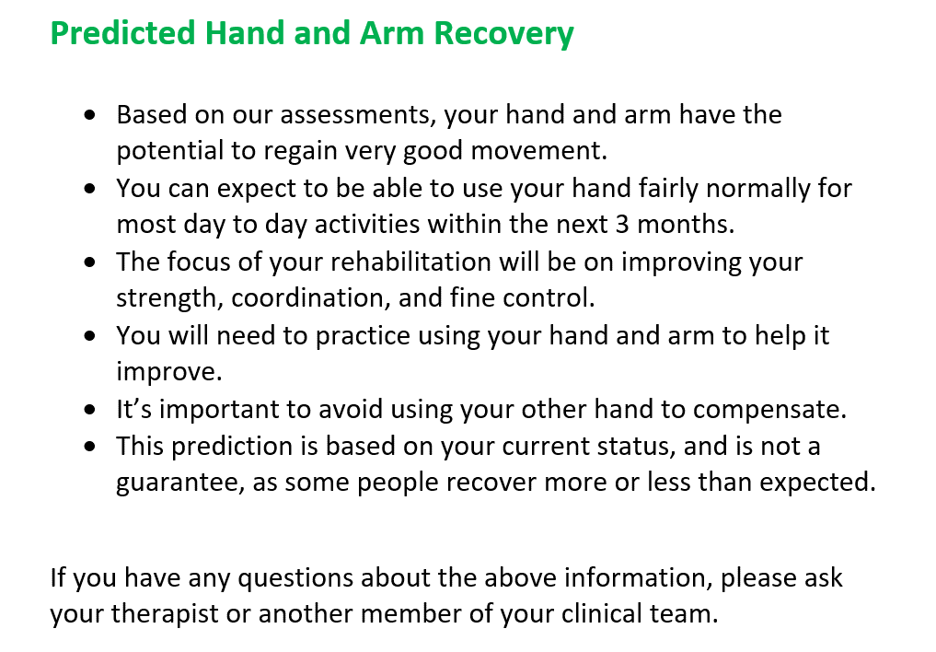
Excellent - Promote normal function
Notes:
Note
*Replace image with your organisations documentation for the ‘Excellent’ prediction handout for patients*
This is the information that will be given to patients with an ‘Excellent’ prediction.
The information it contains is on the PRESTO website.

Slide 21
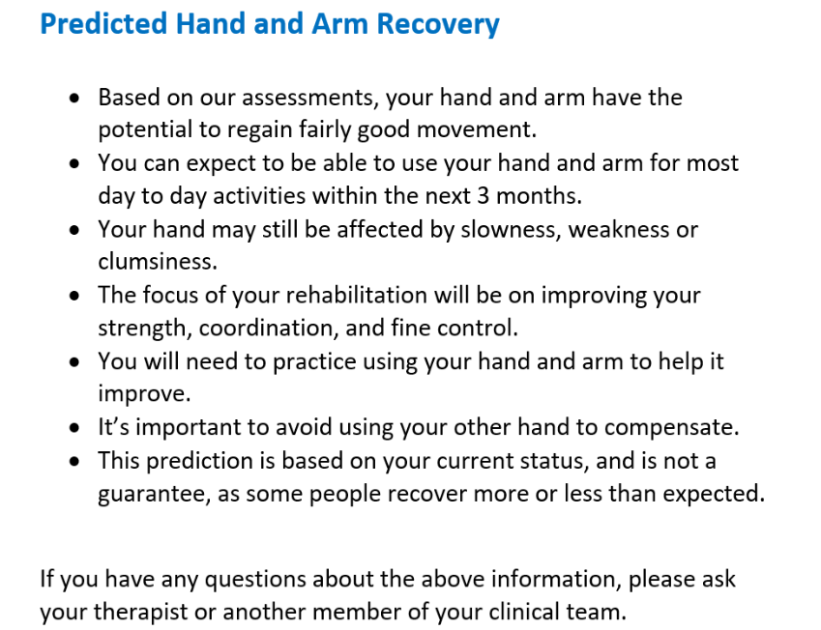
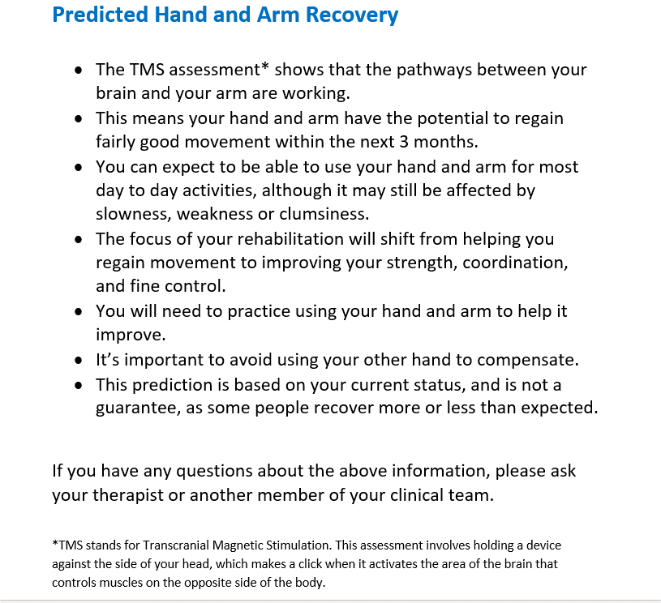
Good - Promote function
Notes:
Note
*Replace image with your organisations documentation for the ‘Good’ prediction handout for patients*
There are 2 versions of the Good prediction handout.
A patient will receive one or the other depending on their Day 3 SAFE score.
(The information contained is on the PRESTO website.)
On the left is the information that will be given to patients with a Day 3 SAFE score of 5,6 or 7 who are aged 80 or older.
On the right is the information that will be given to patients with a ‘Good’ prediction that have required TMS testing as their Day 3 SAFE score was <5 and found to be MEP+.
This information is slightly different as it acknowledges the TMS findings and indicates a need for progression in the focus of rehabilitation as upper limb movement returns, as they are starting from a position of more initial impairment.

Slide 22
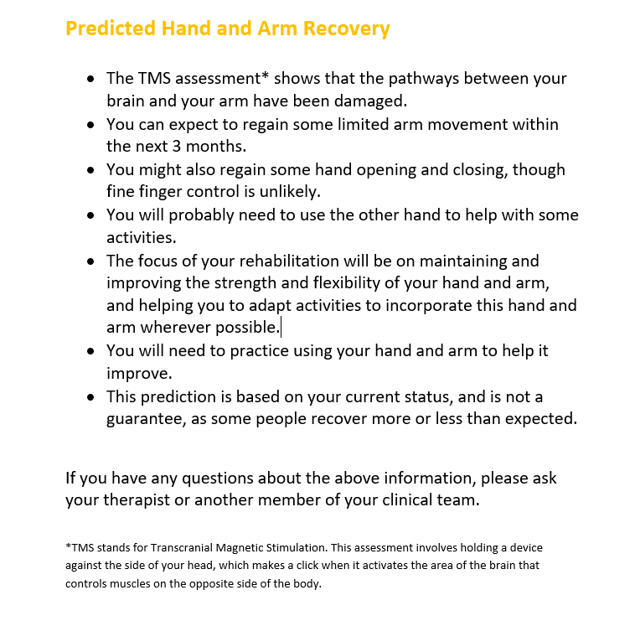
Limited - Promote movement
Notes:
Note
*Replace image with your organisations documentation for the ‘Limited’ prediction handout for patients*
This is the information that will be given to patients with a ‘Limited’ prediction, with the TMS result acknowledged.
(The information it contains is on the PRESTO website.)

Slide 23
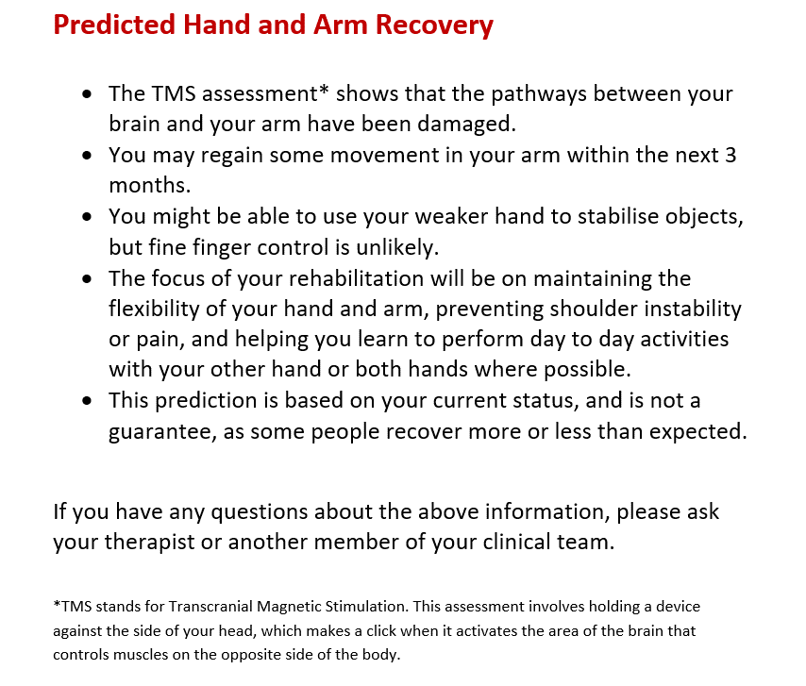
Poor- Promote compensation
Notes:
Note
*Replace image with your organisations documentation for the ‘Poor’ prediction handout for patients*
This is the information that will be given to patients with a ‘Poor’ prediction, with the TMS finding acknowledged.
(The information it contains is on the PRESTO website.)

Slide 24
How are predictions shared?
With the patient:
  Verbal explanation
  Written handout
  Ongoing conversation
Notes:
After receiving a PREP2 prediction a patient and their family might have questions about their hand and arm recovery. These can come up at any stage of their rehabilitation journey.
A patient, and their family, should be able to discuss their PREP2 prediction with their therapists or the wider clinical team at any stage, including inpatient, outpatient, and community rehabilitation.
Therefore it is important for everyone in these clinical teams to be aware of PREP2 and its implications, to ensure a consistent, coordinated approach. Shared knowledge of PREP2 will help to reinforce the information shared with the patient and the subsequent management of their upper limb rehabilitation.

Slide 25
How are predictions shared?
With the clinical team:
  In the clinical notes
Notes:
PREP2 assessments and the prediction will be recorded in the clinical notes, so the information is available and understandable to the whole clinical team.
It is worth noting here that PREP2 can be implemented in 2 phases and the documentation may look different depending on whether you are in Phase 1 or Phase 2 of implementation.

Slide 26
Phased PREP2 Implementation
Phase 1
Phase 2 adds NIHSS and TMS capability
Stinear et al., Ann Clin Transl Neurol, 2017
Notes:
Note *You might want to add slides or go into more detail about what Phase 1 and Phase 2 look like at your organisation*
Phase 1 uses PREP2 for patients with a SAFE score of 5 or more, and doesn’t require transcranial magnetic stimulation (TMS) or NIHSS testing. It uses the top half of the prediction tool. About two thirds of patients will come through this top half of the prediction tool, and a prediction can be made for them with just the SAFE score and their age. Only Excellent and Good predictions can be delivered at this stage.
Phase 2 adds NIHSS and TMS capability so that predictions can be made for patients with a SAFE score less than 5. All predictions can be given.

Slide 27
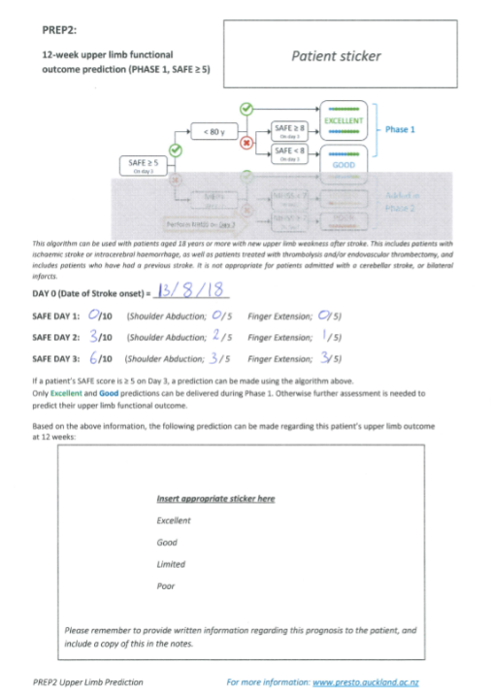
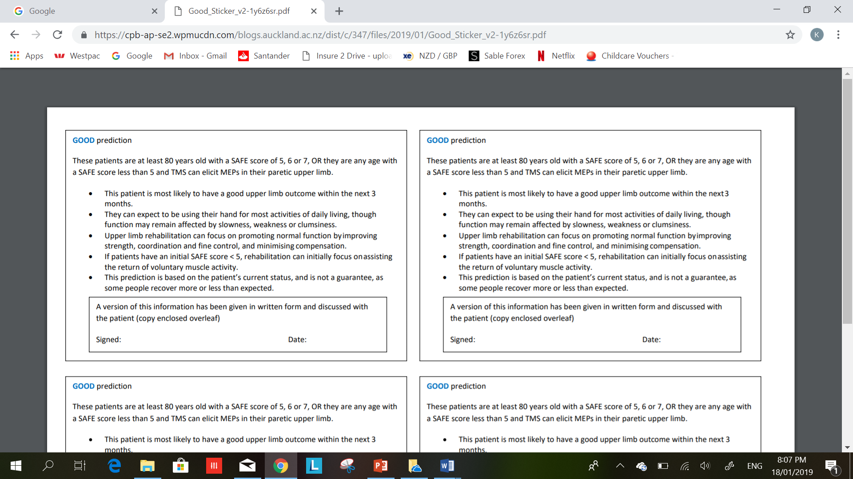
How are predictions shared?
Notes:
Notes
*If you can, replace image with your organisations documentation for Phase 1 PREP2 Assessment for the clinical notes*
For Phase 1:
This is an example of an assessment form for Phase 1, it has been modified from a form used at Auckland District Health Board, New Zealand who first implemented PREP2.
It allows space for a sticker at the bottom of the form where the prediction information is placed for the patients clinical team.
In this example, a ‘Good’ prediction would be made because the SAFE score was 6/10 on Day 3 and the patient was older than 80.
Remind audience when showing Phase 1 documentation that:
Phase 1 uses SAFE score and age only
Patients with a SAFE score of at least 5 can be given a prediction (this is about 2/3rds of patients)
Only Excellent and Good predictions can be given

Slide 28
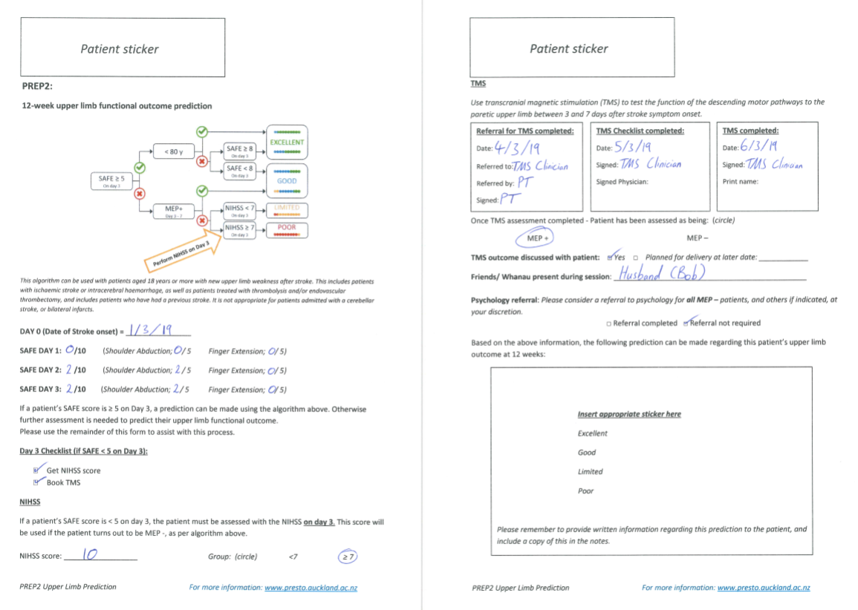
Mrs Bloggs F Age: 82 y
ABC1234
Mrs Bloggs F Age: 82 y
ABC1234
How are predictions shared?
Notes:
Note:
*If you can, replace image with your organisations documentation for Full PREP2 Assessment for the clinical notes*
For Phase 2:
This is an example of an assessment form for Phase 2, it has been modified from a form used at Auckland District Health Board, New Zealand who first implemented PREP2.
Remind audience when showing full PREP2 assessment documentation that:
Phase 2 adds includes NIHSS and TMS assessment details, and all predictions can be given.
In this example: A ‘Good’ prediction would be made as the SAFE score was 2/10 on Day 3 and TMS testing was MEP+. The NIHSS score obtained on Day 3 is not required for determining the prediction.

Slide 29
How are predictions shared?
With the clinical team:
  In the clinical notes
  Shared at multi-disciplinary team meetings
  Handed-over to future clinical teams/services
  In discharge summaries
Notes:
PREP2 information should also be shared at team meetings and handed over to future clinical teams at any ongoing patient services.
PREP2 information may also be added to the discharge summary (Note: check that this is the case at your organisation)

Slide 30
Implications
PREP2 prediction information can help with realistic goal setting and discharge planning for clinicians and patients
Information isn’t useful unless we use it!
Team all need to be the same page
Consistent message
Information needs to travel with the patient
Notes:
Before finishing, we’ll just revisit some important points.
PREP2 prediction information can help set realistic goals for recovery and rehabilitation, and help make informed decisions regarding rehabilitation opportunities and discharge planning.
But it is important to remember that:
- The information isn’t useful unless we use it.
- As a clinical team we all need to be on the same page, and giving the patient a consistent message.
- Prediction information also needs to travel with a patient as they go through the rehabilitation services
As clinical teams across the scope of our rehabilitation services, being on the same page will really help our patients understand their situation and maximise their potential.

Slide 31

Notes:
Thank you for reinforcing PREP2 predictions, answering questions, and supporting the focus for upper limb management!

Slide 32
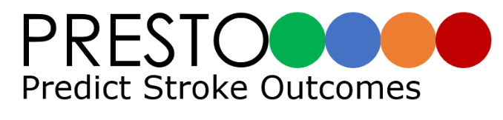

What’s next?
We are presenting PREP2 information to staff throughout the continuum of patient care
We’ll check in on how things are going
We’ll share any updates as required
www.presto.auckland.ac.nz
www.preptraining.auckland.ac.nz
*Name* *Email* *Phone*
Notes:
What’s next?
We are currently ensuring all staff throughout the continuum of patient care are informed about PREP2 (As necessary, add information about Phase and start dates).
We’ll check in on how things are going for you as we move forward, and we’ll also come back and give you any updated information as required
In the meantime, please visit the PRESTO and the PREP2 training website for further information on PREP2 or feel free to make contact.

Slide 33


Questions?
www.presto.auckland.ac.nz
www.preptraining.auckland.ac.nz
*Name* *Email* *Phone*

